Slide 1
L&D recap 1
Design Thinking

Slide 2

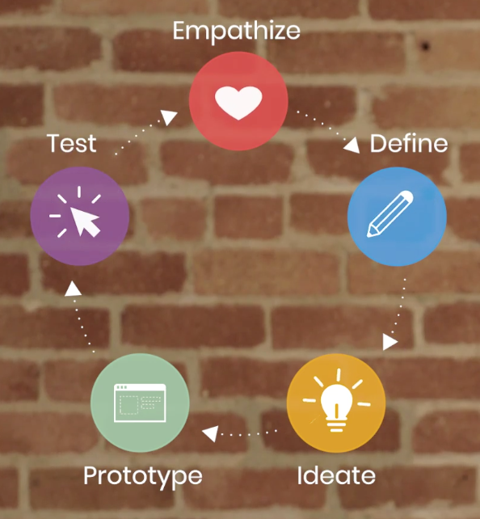
What was your main takeaway or learning from the design thinking course?

Slide 3
What did you not like about the design thinking course?

Slide 4
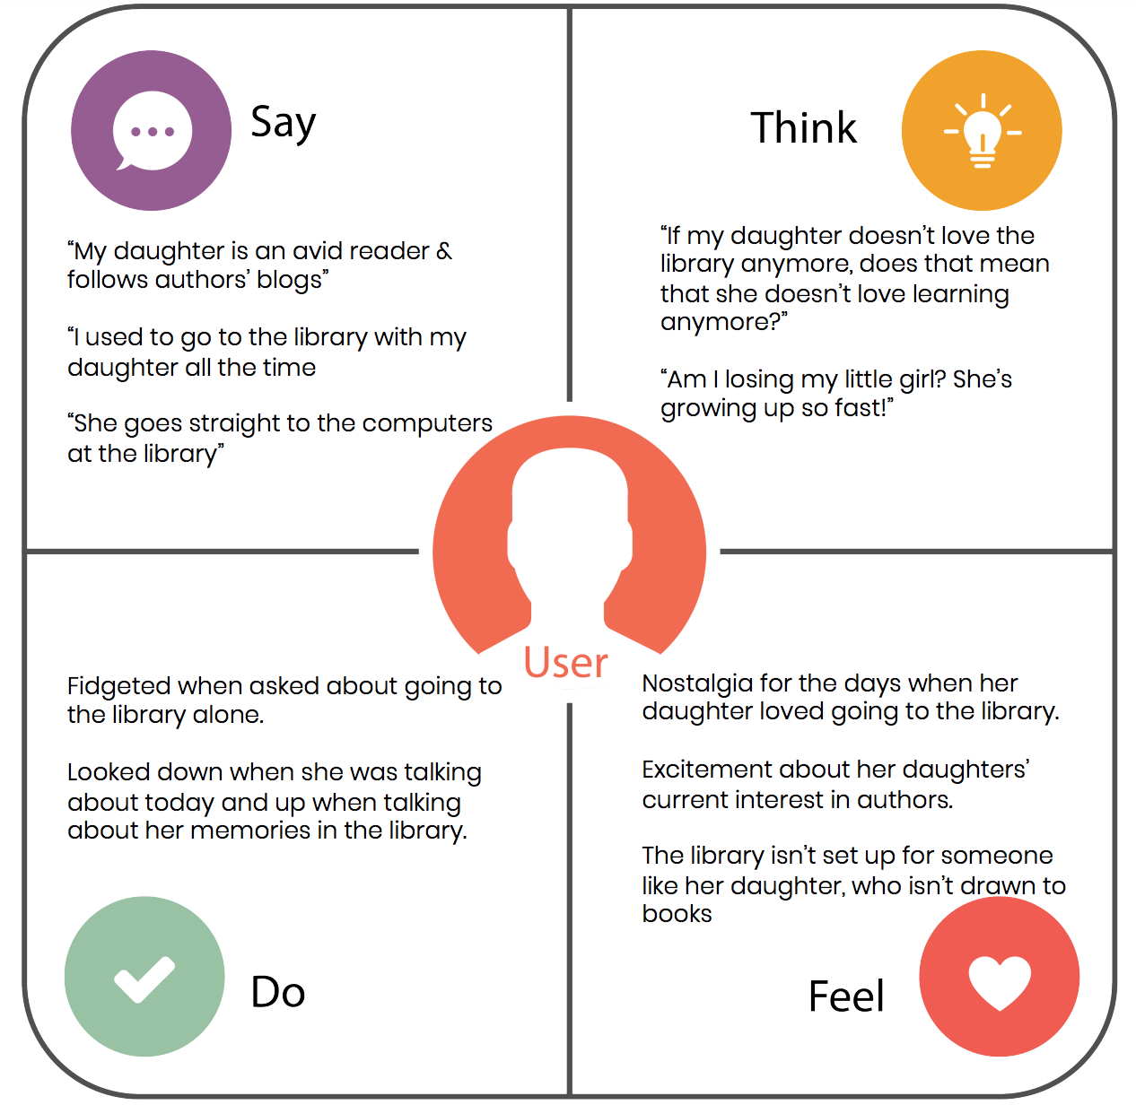
Say - Do - Think - Feel
Take a product or feature you have worked on and think about your main user.
Then complete a say think feel do slide.
You have 5 minutes to jot down your thoughts.

Slide 5
Linda - STS/SDS Pump
SAY: I cannot finish my refills due to the frequent pump breakdown. I want a pump that does experience this many issues. | THINK: Do we have the right pump for the job?
DO: Maintenance technician on standby ready to go to the MT location to fix the pump. Stock twice as many pumps | FEEL: Need to get this right the second time round Comprehensive testing of the proposed pump

Slide 6
Create 4 boxes on a slide (Ceesay-Fuel Planning Tools)
“This system takes too long to execute our scheduling tasks” “Its constantly making us work overtime, really early mornings and we literally can’t do anything else during the day” “We don’t reach our goals despite the hard work and frustrations” | They think PMs don’t listen to their issues very well or take them seriously.
They created a lot of work arounds that became the operational norm for both scheduler and operators despite the huge effort it takes | They feel like the PM needs to walk in their shoes to truly understand their issues and deliver something impactful They feel like the only way to be taken seriously is to send out emails to almost half of KOKO for their issues to be resolved. They feel like their solution proposals were better than anything “an outsider” could come up with.

Slide 7
Create 4 boxes on a slide (Ceesay)

Slide 8
Billy - Customer Care
Say Can’t access support history Don’t know support status Don’t know who’s responsible | Think There’s no sufficient customer data No effective support pipeline No coordination
Do Delegate support to other members/teams Delayed ticket resolution Disorganized field support | Feel: Frustrated with support tools Unable to assist customers Ineffective support pipeline

Slide 10
David - UVC
Say Can’t see all the data for a customer Don’t have visibility of what is happening and who does what Person X keeps doing wrong thing | Think People are gaming the system People are doing the wrong thing Things aren’t efficient/effective
Do Manual reports and reviews Preconceived ideas about what is happening Implement own checks and processes to try to address | Feel A lot to fix, overwhelming Frustration Concern re what may be happening and risk

Slide 11
Alice - Agent Finance
Say “The process for calculating agent payments is painful. “ “The system is not reliable” | Think Current system is not automated enough and pushes an admin burden onto the Finance team Worry about impact on audit when paid out numbers are reviewed against statements and they dont match
Feel Mistrust in the numbers coming from the system - having to cross check everything against different reports One problem usually leads to another | Do Manual reconciliation for each agent Have to hire extra people Sending a lot emails, tickets and calls each month, not always getting a clear answer

Slide 12
Violet-Onboarding
Say The process is not well mapped out between all the involved teams | Think We are missing on SLAs because communication of task completion is not good
Do Everyone has a spreadsheet for their own tasks | Feel The process is not efficient because communication is there

